Slide 1
BIO 101: Introductory Biology Osinaike T.S. (Lecture C19 – 2)
GROWTH AND REPRODUCTION

Slide 2
GROWTH AND REPRODUCTION
All living things have the ability to grow, reproduce and die, leaving behind their progeny.
Growth and reproduction processes are not the same in different species.

Slide 3
GROWTH
Unicellular and multicellular organisms have to grow throughout or during their life cycle.
Repairs of damaged tissue also occur in the multicellular forms.
Growth is the irreversible change in size of cells, tissues, organs and whole organisms
This process of irreversible increase in size (height, girth, volume, weight) of an organism or plant biomass in a particular community, occurs as a result of increase in cell size and number (due to both cell division and enlargement), in the body of the individual organism.

Slide 4
GROWTH CONT’D
Growth is measured as a unit of size per time.
It occurs throughout the lifespan of plants and some animals.
Cell(s) enlargement is caused by changes in the elasticity of the cell walls or membranes, together with an increase in the size and water content of the vacuole, resulting in increase body size of the organism.

Slide 5
Growth can be determinate—when an organ or part or whole organism reaches a certain size and then stops growing—or indeterminate—when cells continue to divide indefinitely
Plants in general have indeterminate growth.
Mitosis is the means by which organisms grow. It is also the method through which unicellular organisms replicate themselves vegetatively by e.g. fragmentation (Nostoc), binary fission(Amoeba), budding (Saccharomyces cerevisae).

Slide 6
REPRODUCTION
Reproduction (or procreation) is the biological process by which new individual organism exists.
There are two forms of reproduction: asexual and sexual.

Slide 7
ASEXUAL REPRODUCTION
In asexual reproduction, an organism can reproduce without the involvement of another organism.
Asexual reproduction is common but not limited to single-celled organisms.
The cloning of a multi-celled organism is a form of asexual reproduction.
By asexual reproduction, an organism creates a genetically similar or identical copy of itself.
The cell is able to do so by dividing mitotically, this process allows organisms to create genetically similar or identical copies of themselves without the contribution of genetic material from another organism.

Slide 8
TYPES OF ASEXUAL REPRODUCTION
Binary fission: Bacteria, Amoeba and other protist divide asexually by binary fission;
Replication: Viruses take control of host cells to produce more viruses;
Budding: Hydras (invertebrates of the order Hydroidea) and yeasts (Saccaromyces cereviseae) are examples of organisms that reproduce by budding;
Fragmentation: It is a common method of reproduction used by some species of asteroids, ophiuroids, and holothurians, and in some of these species sexual reproduction is not known to occur.

Slide 9
ASEXUAL REPRODUCTION
Most plants have the ability to reproduce asexually and the ant species Mycocepurus smithii is thought to reproduce entirely by asexual means.
Some species that are capable of reproducing asexually, like hydra, yeast and jellyfish, may also reproduce sexually.
Most plants are also capable of vegetative reproduction—reproduction without seeds or spores—but can also reproduce sexually.
Likewise, bacteria may exchange genetic information by conjugation which is a type of sexual reproduction.

Slide 10
ASEXUAL REPRODUCTION CONT’D
Other ways of asexual reproduction include parthenogenesis, fragmentation and spore formation that involves only mitosis.
Parthenogenesis is the growth and development of female (ovule) into young embryo without fertilization by a male.
Parthenogenesis occurs naturally in some species, including plants (where it is called apomixis), invertebrates (e.g. water fleas, aphids, parasitic wasps), and vertebrates (e.g. some reptiles, fish, and, very rarely birds and sharks).
It is sometimes also used to describe reproduction modes in hermaphroditic species which can self fertilize.

Slide 11
SEXUAL REPRODUCTION
Sexual reproduction typically requires the sexual interaction of two specialized cells of organisms, called gametes, which contain half the number of chromosomes of normal cells and are created by meiosis, with typically a male fertilizing a female of the same species to create a fertilized zygote.
This produces offspring organisms whose genetic characteristics are derived from those of the two parental organisms.

Slide 12
SEXUAL REPRODUCTION CONT’D
It is a biological process that creates a new organism by combining the genetic material of two organisms thereby creating a not exact copy of either parent but a mixture of their genome.
Each of two parent organisms contributes half of the offspring’s genetic makeup by creating haploid gametes.
Most organisms form two different types of gametes. In these anisogamous species, the two sexes are referred to as male (producing sperm or microspores) and female (producing ova or megaspores.

Slide 13
SEXUAL REPRODUCTION CONT’D
In isogamous species, the gametes are similar or identical in form (isogametes), but may have separable properties and then may be given other different names.
For example, in the green algae eg Chlamydomonas spp, there are s “plus” and “minus” gametes (gram positive and gram negative strains).
A few organisms such as ciliates, Paramecium have more than two types of sex called syngens.
Some other type, the Oogamous species have non–motile bigger ovum or egg (female gamete) and motile small sperm (male gamete) a good example is human being.

Slide 14
SEXUAL REPRODUCTION CONT’D
Higher animals (including humans) and plants reproduce only sexually.
Sexual reproducing organisms have different sets of genes for every trait (called alleles). Offspring inherit one allele for each trait from each parent.
Thereby ensuring that offspring have a combination of the parents’ genes.
Diploid having two copies of every gene within an organism, it is believed that “the masking of deleterious alleles favours the evolution of a dominant diploid phase in organisms that alternate between haploid and diploid phase “here recombination occurs freely.

Slide 15
SEXUAL REPRODUCTION CONT’D
Bryophytes reproduce sexually but the commonly seen/ dominant life forms are all haploid, which produce gametes.
The zygotes of the gametes develop into sporangium. which produces haploid spores.
The diploid stage is relatively short compared with that of haploid stage. i.e. haploid dominance.
The advantage of diploid, e.g. heterosis (increased function of any biological quality in a hybrid offspring), only takes place in diploid life stage.

Slide 16
SEXUAL REPRODUCTION CONT’D
Bryophyte still maintains the sexual reproduction during its evolution despite the fact that the haploid stage does not benefit from heterosis at all.
This may be an example that the sexual reproduction has a bigger advantage by itself, since it allows gene shuffling (hybrid or recombination between multiple loci) among different members of the species, that permits natural selection of the fit over these new hybrids or recombinants that are haploid forms.

Slide 17
ALLOGAMY
Cross fertilization between individuals of a species.
Also used for cross pollination.
Allogamy is the fertilization of an ovum from one individual with the spermatozoa of another.
Some higher plants are either, protoandrous or protogynous when the male or female reproductive part are mature before the other respectively, making it impossible for self-fertilization to occur.

Slide 18
AUTOGAMY
Self-fertilization, sometimes referred to as geitogamy, occurs in hermaphroditic organisms where the two gametes fused in fertilization come from the same individual, e.g., some foraminifera (forams) and some ciliates.
The term “autogamy” is also used for pollination (not necessarily leading to successful fertilization) and describes self-pollination within the same flower, distinguished from geitogamy, transfer of pollen to a different flower on the same flowering plant, or within a single monoecious Gymnosperm plant.
For example, species Helonias bullata suffer for low self-fertilization.
Some flowering plants are cleistogamous or chasmogamous a type of self-fertilization in which the flowers do not open to allow pollen from another to pollinate the flower of the plant e.g. Viola pubescens.

Slide 19
ACTIVITY & ASSIGNMENT
Activity: Study these processes in angiosperms
i. Microgametogenesis (male gametes production) +
ii. Megametogenesis (ovum production) =
iii. Oogamy.
Assignment: Give briefly in your notes, key points on gametogenesis and sporogenesis. Give the main differences between oogenesis and spermatogenesis processes

Slide 20
THE CELL CYCLE
There are two phases of the cell cycle, the Growth phase and Division phase.
The Growth phase of the cell cycle- this the resting phase or interphase.
The cell is actually most active during the interphase and there are three distinct phases detected with interphase G₁, S and G₂
G₁ (Gap 1) phase –This is the first stage after cell division when new daughter cells have just been made.
The cell is recovering from division and conducting most of its normal metabolism.

Slide 21
THE CELL CYCLE CONT’D
One important process is synthesis of nucleotides that are used for DNA replication.
It is the longest period in the cycle of any organism.
S (Synthesis) phase – During the synthesis phase the genes in the nucleus are replicated.
Gene is segments located on DNA which is a polymer of nucleotides. Each gene has a unique sequence of nucleotides.
Many higher plants and animals need about 100, 000s types of genes to store all the information required to make proper enzymes, structural, regulatory, transport proteins, and hormones needed for the organism’s life.

Slide 22
THE CELL CYCLE CONT’D
The whole complex of genes for an organism is its “genome”.
Several, up to thousands of genes attached together in linear sequence in a structure called chromosomes.
Although it might be reasonable for all these to link together in a single chromosome, but such a long chromosome will be hopelessly tangled, therefore the genes are lined on more than one chromosome.
Only a few plants have as few as two chromosomes for their genome.
Most have five (5) to thirty(30) chromosomes.
Humans have forty six (46) chromosomes.

Slide 23
TABLE NUMBER OF CHROMOSOMES IN A DIPLOID SET IN SOME COMMON PLANTS SPECIES.
Plant species | Common name | Number of chromosome
Allium cepa | Onion | 16
Beta vulgaris | Beet | 16
Oryza sativa | Rice | 24
Pisum sativum | Pea | 14
Solanum tuberosum | Potato | 48
Vicia faba | Broad bean | 12

Slide 24
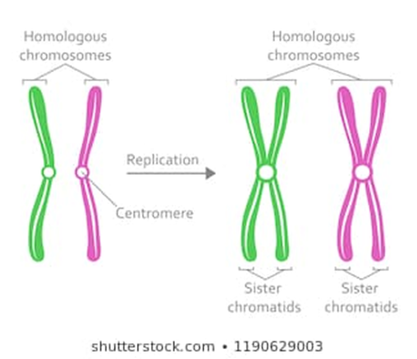
DNA pieces are linked by the centromere. Before the S phase each chromosome has one chromatid and a copy of each gene, after S phase each chromosome has two chromatids (sister chromatids) and two copies of each gene.
Diagram: formation of sister chromatids

Slide 25
Note* many cells stop at G₁ and do not proceed to the S phase when they cease dividing and begin to differentiate or get matured
G₂ (Gap 2) phase – Following the S phase, the cell progresses into G₂ phase during which cells prepare for division.
This phase usually lasts only about 3 to 5 hours.
The alpha and beta tubulin necessary for the spindle microtubule is synthesized, the cell is believed to produce proteins necessary for processing chromosomes and breaking down the nuclear envelope.
After the G₂ phase division of cell can occur.

Slide 26
DIVISION PHASE OF THE CELL CYCLE
The actual division involves two processes
Division of the nucleus called karyokinesis and
Division of the protoplasm called cytokinesis
Karyokinesis: there are two types of karyokinesis
Mitosis leading to growth of organisms or during vegetative reproduction
Meiosis leading to the formation of gametes during sexual reproduction.

Slide 27
MITOSIS
Mitosis is the duplication division, it is the more common type of karyokinesis.
It is the method that any multicellular organism uses to grow its body.
It is also used used by eukaryotic unicellular organisms, when they are not undergoing sexual reproduction.
Mitosis is called duplication division because the nuclear genes are first copied and one set of genes is separated from the other and each set packed into its own nucleus.

Slide 28
MITOSIS CONT’D
Each daughter nucleus is thus basically a complete replicate of mother nucleus and a twin of one another, except for when occasional errors occur.
Mitosis consists of the following four (4) phases.
Prophase
Metaphase
Anaphase and
Telophase

Slide 29
PROPHASE STAGE
Chromosome condense, become shorter and thicker by coiling repeatedly until visible.
The chromosomes now move easily within the cell.
Nucleolus (organelles within the nucleus where RNA are synthesised and assembled) becomes less distinct or disappears.
Nuclear envelope/membrane is broken down by action of enzymes.
Sister chromatids migrate to opposite poles of the cell.
Spindles (long set of microtubules) from opposite poles are formed and attached to the centromere.

Slide 30
METAPHASE STAGE
Once spindles are formed, chromosomes are pulled together to the centre and aligned.
Centromere are duplicated.
The chromatids separate and are free of one another.
Number of chromosome is doubled but the size is halved

Slide 31
ANAPHASE STAGE
Spindles are shortened
Each daughter chromosome is pulled away from its twin.
Chromosome at each end of the cell is pulled together into compact space.

Slide 32
TELOPHASE STAGE
Nuclear envelope appear around the two sets of chromosomes at each side of the cell.
Chromosome starts to become less distinct as they start to uncoil.
New nucleolus appear as ribosomal genes become active and produce ribosome.
Spindles depolymerize completely and disappears.
Two nuclei are formed.
Note*: Actions in Telophase are mostly opposite to those in prophase

Slide 33
CYTOKINESIS
The division of the protoplasm or cytoplasm is much simpler than the division of nucleus.
There is a random distribution of mother cell organelles, each daughter cell is made sure to contain some of all the organelles mitochondria, Endoplasmic reticulum, ribosomes lysomsomes vacuole, plastids etc.
During cytokinesis in animal cells, a ring of actin filaments forms at the metaphase plate. The ring contracts, forming a cleavage furrow, which divides the cell in two.

Slide 34
CYTOKINESIS
In plants the process involves a little more complex process.
First the formation of a plates – phragmoplast (set of short microtubules orientated parallel to the spindle microtubules) , fomed by golgi vesicles coalesce, catch dictyosomes, taking them towards original cell wall.
A cell plate is then formed.
The dictyosomes grow outwards making new wall which extend outward along the edge.
The new walls meet and fuse with old/mother cell wall, thereby completing the division of the mother cell into daughter cells

Slide 35
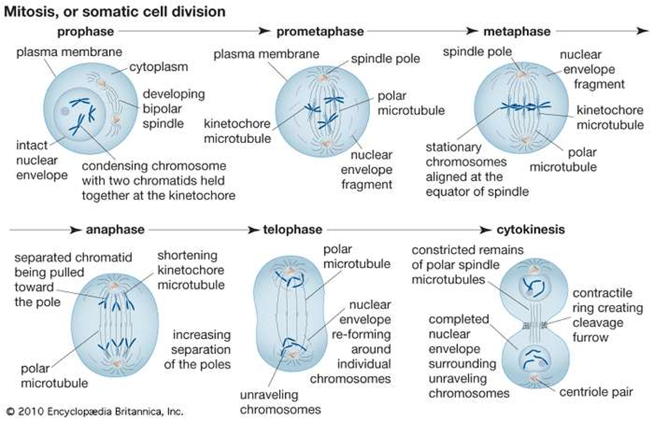
MITOSIS/SOMATIC CELL DIVISION

Slide 36
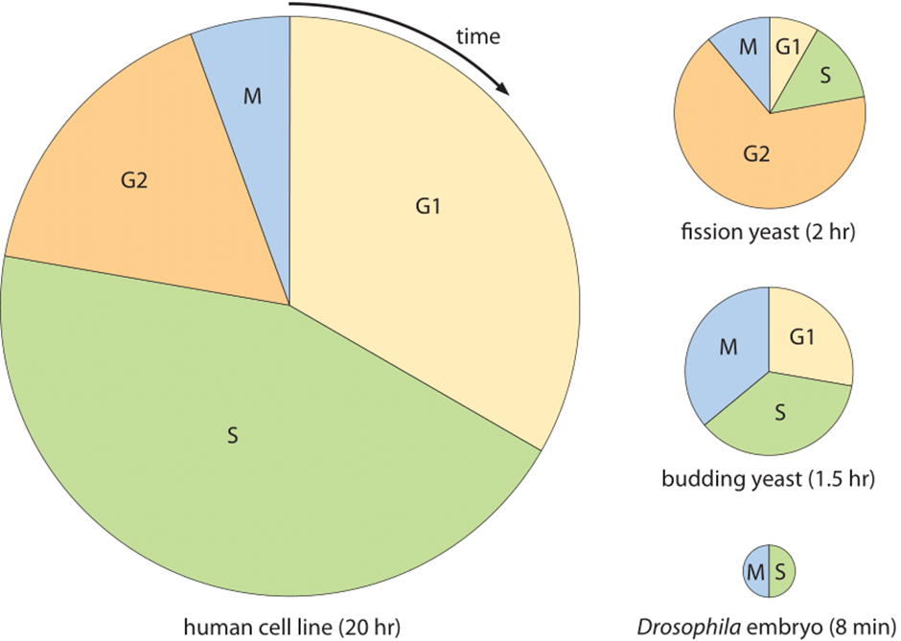
DURATION OF LIFE CYCLE PHASES IN DIFERRENT ORGANISMS

Slide 37
MEIOSIS
In mitosis daughter nuclei are replicates of the original mother nucleus, this is necessary for the growth of an organism and haploid or diploid unicellular organisms that multiply vegetatively or reproduce asexually.
However it creates a problem when sexual reproduction occurs if the adult were to produce gametes by mitosis, the gametes would be diploid as well.
The fusion of two diploid gametes will result in tetraploid gametes which will result in tetraploid zygote, with each new generation the zygote continues to double the number of set of gametes which is not possible biologically.
Formation of gametes to reproduce next generation in sexual reproduction must be through a reduction division called meiosis.

Slide 38
MEIOSIS CONT’D
Meiosis occurs only in the production of reproductive cells gametes in animals, some algae and fungi, spores in lower, plants and fungi and seed plants.
Meiosis involves two rounds of division without allowing the S phase to occur after the first division.
The two rounds of divisions are called meiosis I and meiosis II.
Each contains four phases similar in some ways to those of mitosis.
Four haploid daughter nuclei are produced as a result of meiotic division and each contains only one set of chromosome with a single chromatid.

Slide 39
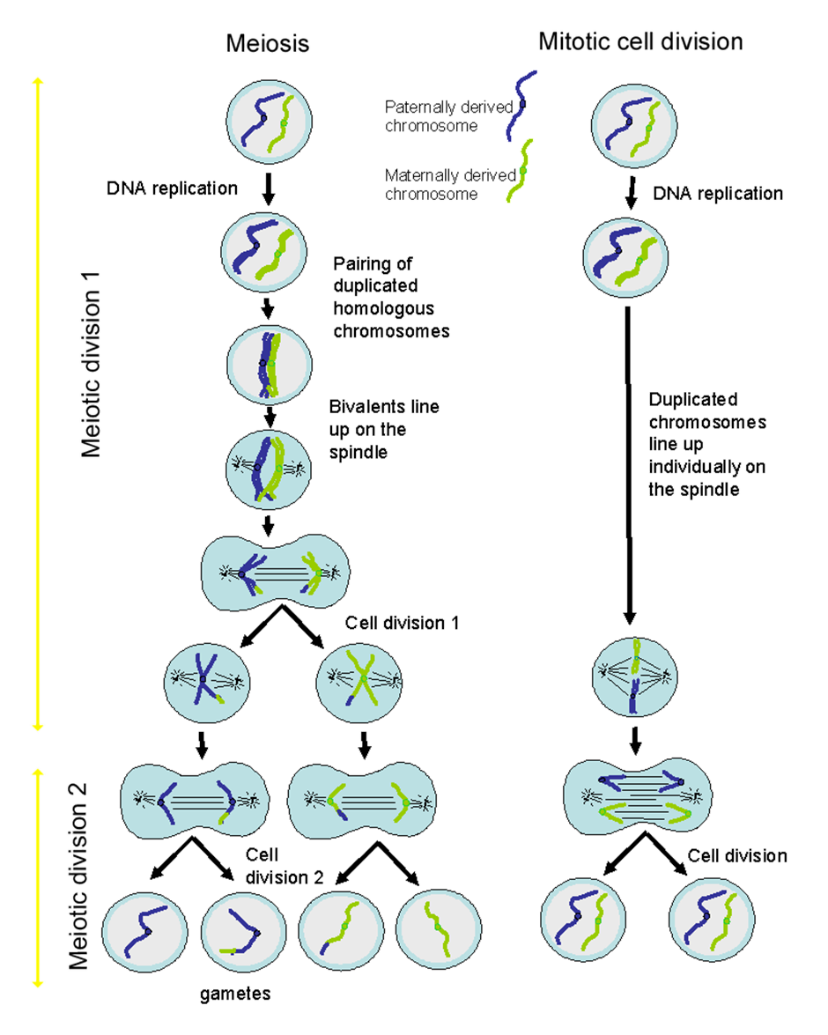
COMPARISOMN OF THE MEIOTOTIC AND MITOTIC CELL DIVISION PROCESSES

